Slide 1

CARE ME
Premium Care
Personal Touch!
Nitin Salvankar
Sunand Pujari
Ushawini Vinnakota
Notes:
To use this title animation slide with a new image simply 1) move the top semi-transparent shape to the side, 2) delete placeholder image, 3) click on the picture icon to add a new picture, 4) Move semi-transparent shape back to original position, 5) Update text on slide.

Slide 2
INTRODUCTION
Goal:
Help study coordinators to conduct studies
Help users take care of their health in a personalized way
ADVANCED MOBILE APPLICATION DEVELOPMENT: Semester Project
Problem statement
Build a system which would have a
Web app for Admin and Study Coordinators to design studies and publish them
Mobile app for user to participate in studies
Mobile app is built in android using ResearchStack framework

Slide 3
DESIGN GOALS
Design Goals and Design Justification
Utility
Easy to use.
Memorability
Intuitive Design.
Learnability
Minimizing the number of steps within the model by giving the user access to the most pertinent parameters of the interface.
Safety
Integrity of Information as it consists of sensitive data.
Effectiveness
Clarity about the process.(The user should agree to share information.)

Slide 4
DESIGN CONCEPT

Slide 5
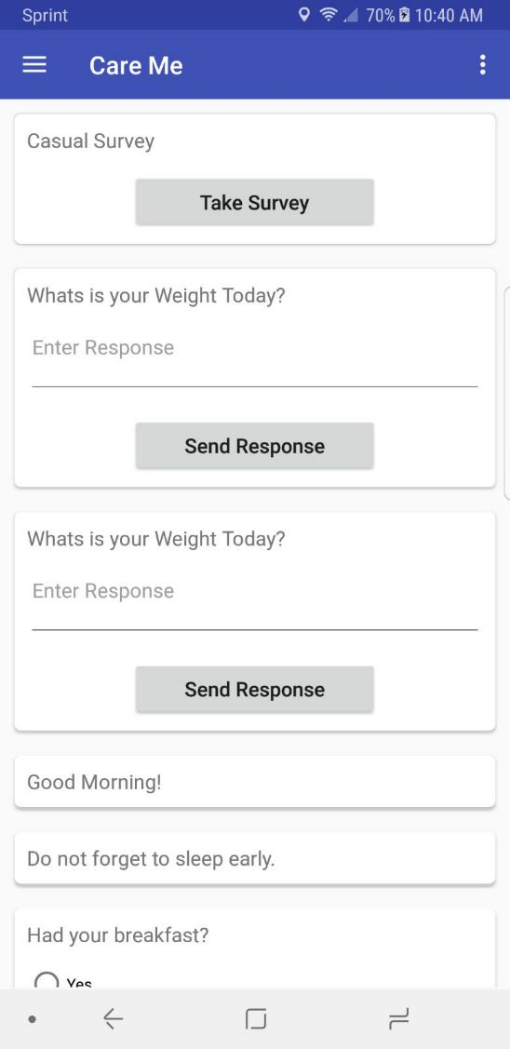
1
A Dashboard for the survey questions.

Slide 6
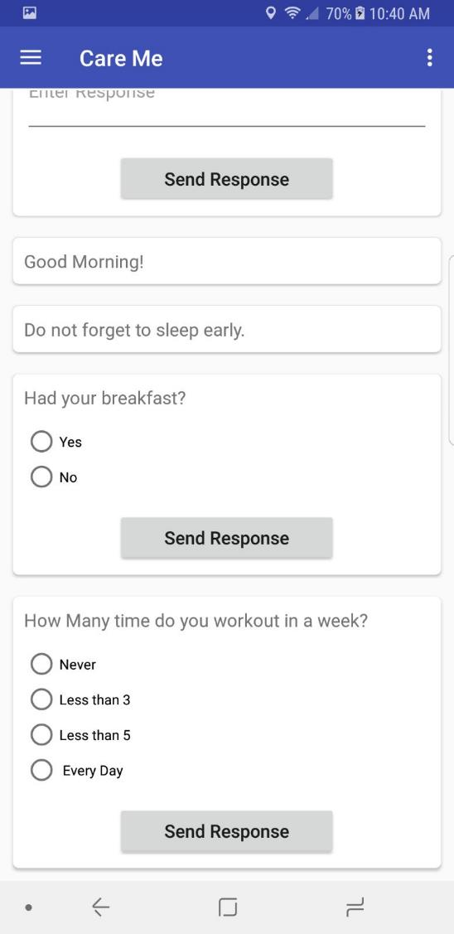
3
3 Message types:
A general message about health.
A Yes/No response question.
A message with response in range.

Slide 7
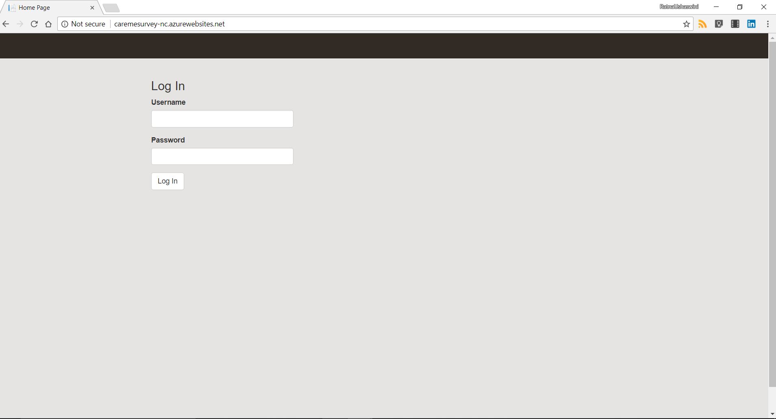
7
Web App Login Screen for both Admin and Study Coordinator

Slide 8
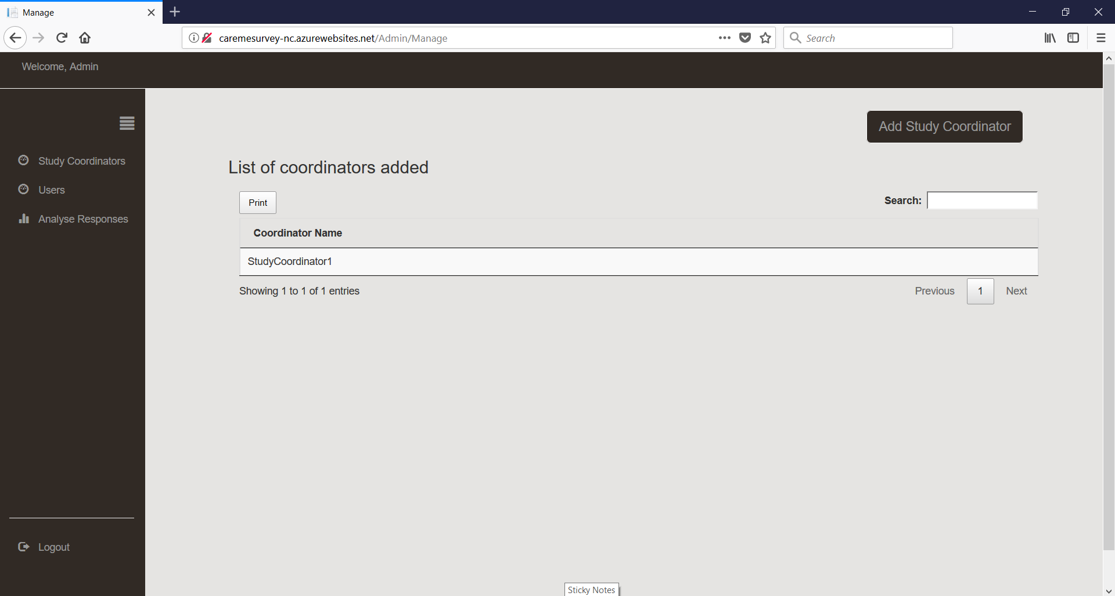
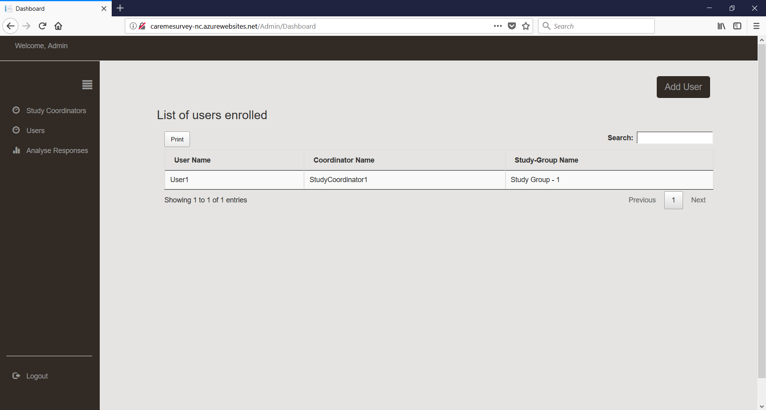
8
Initial Screen of Admin where he can add Study coordinator
9
Initial Screen of Admin where he can add Users

Slide 9
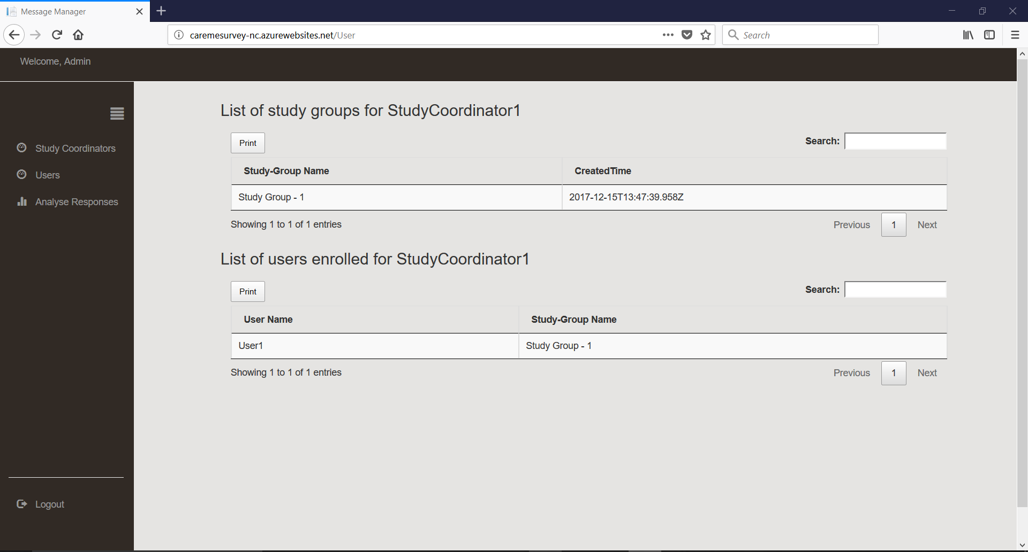
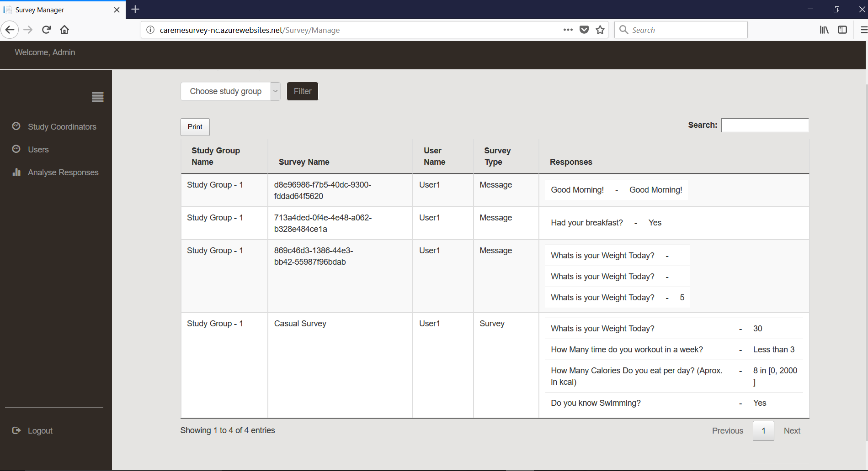
10
List of study groups and users under study coordinator for Admin view
11
Coordinator to add user to study

Slide 10
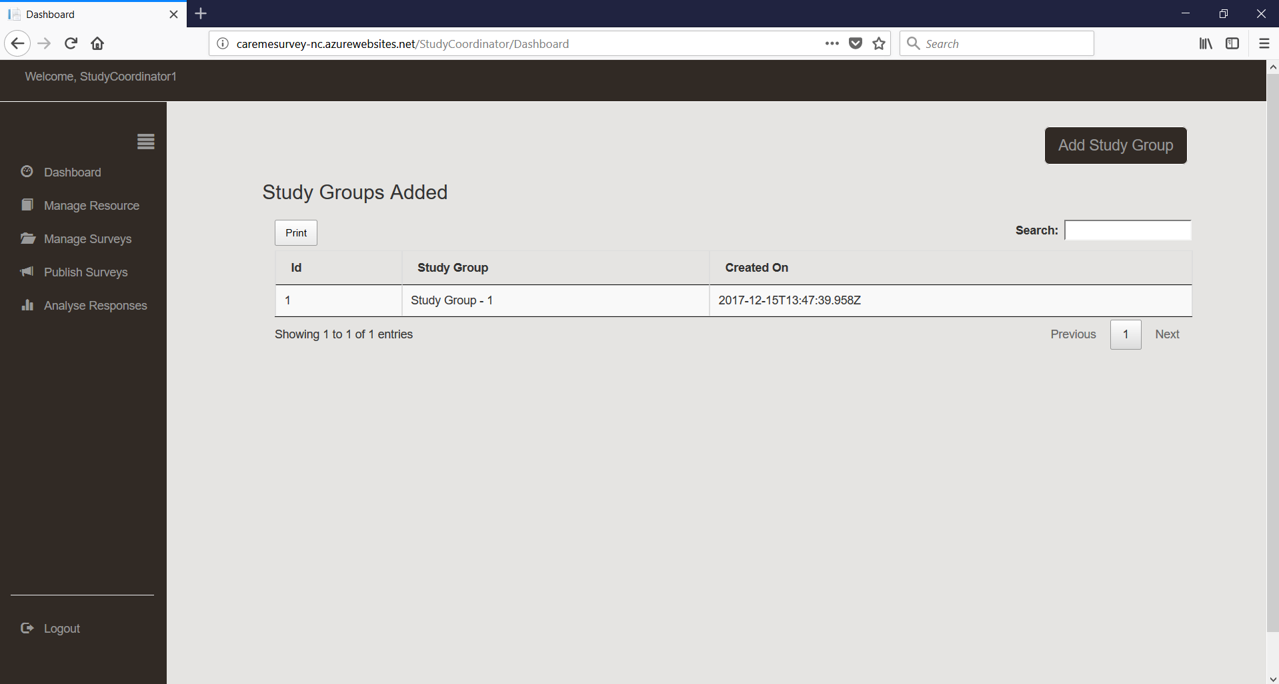
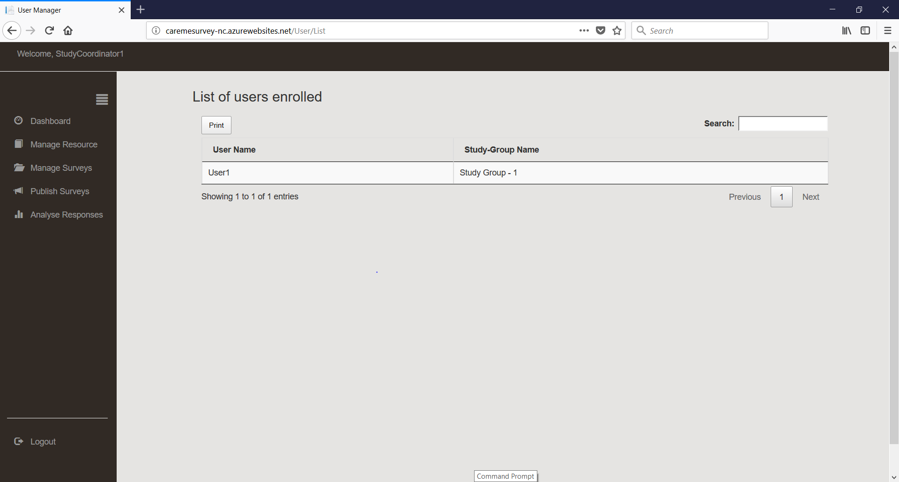
12
Coordinators’ Dashboard where he can see list of study groups under him
13
Coordinator clicking on a particular group gives list of users in that group

Slide 11
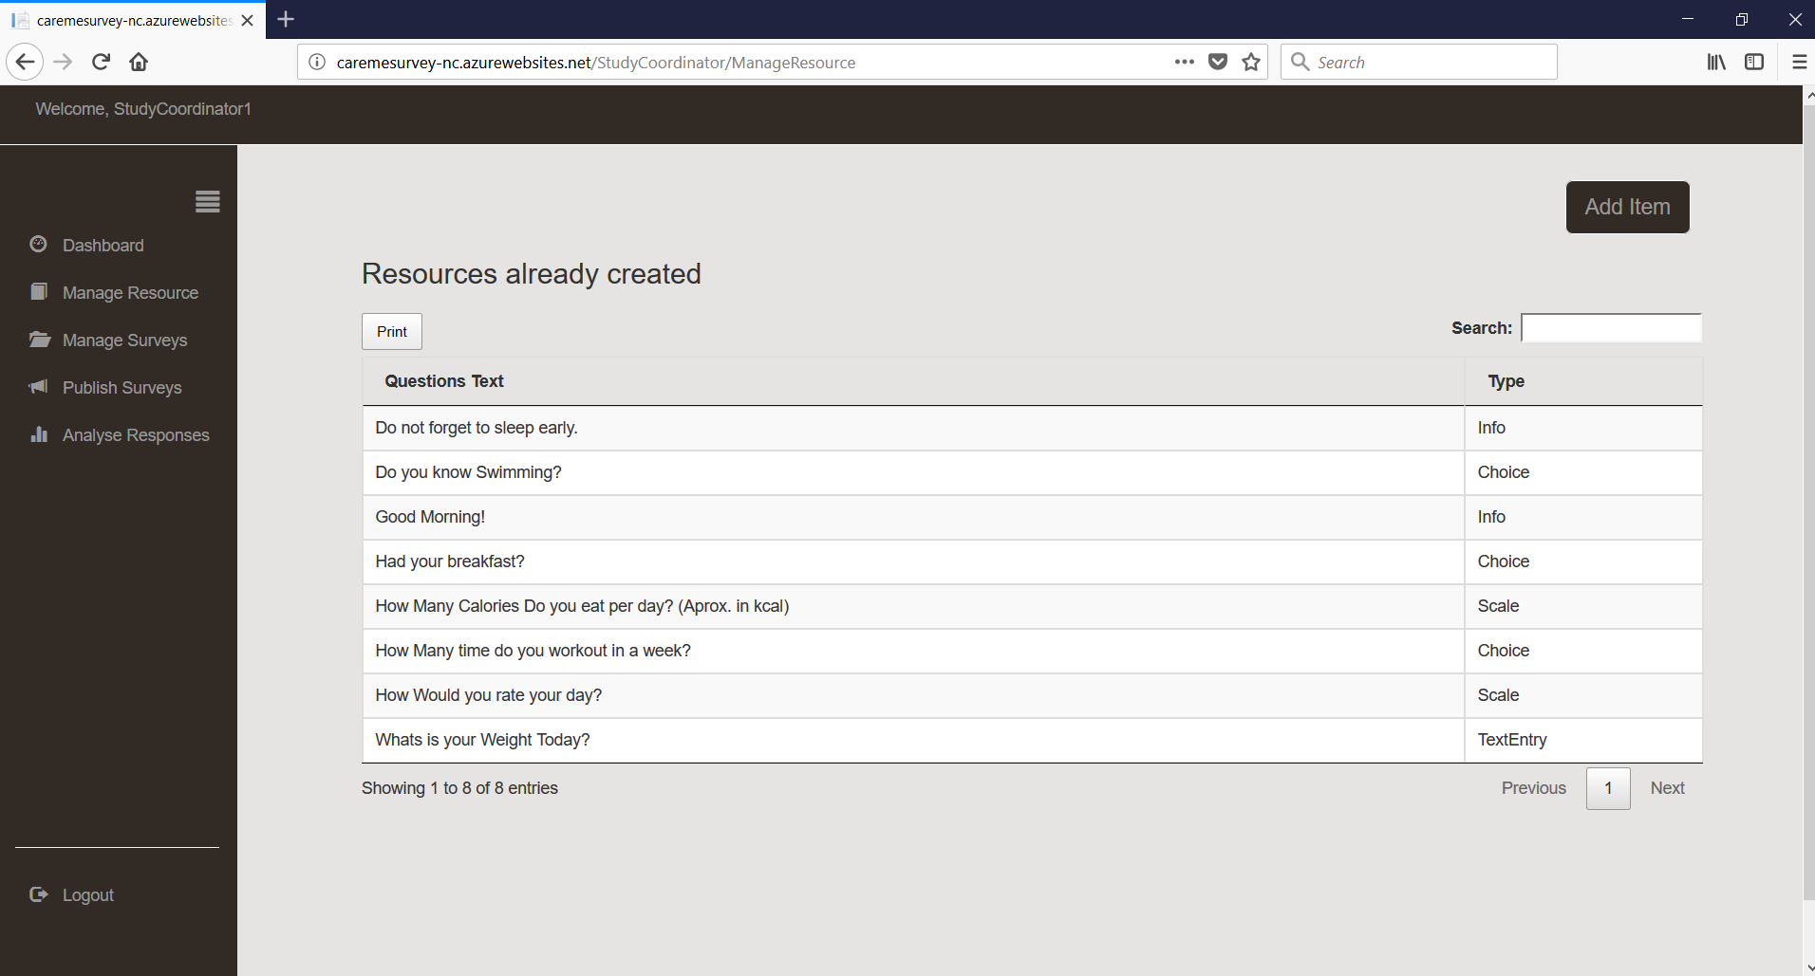
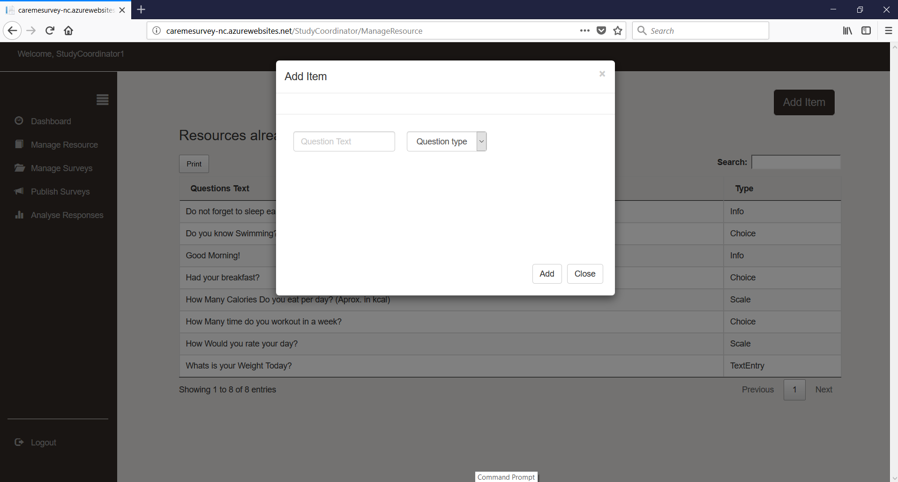
14
Coordinator for creating resources like Questions
15
Preparing questions

Slide 12
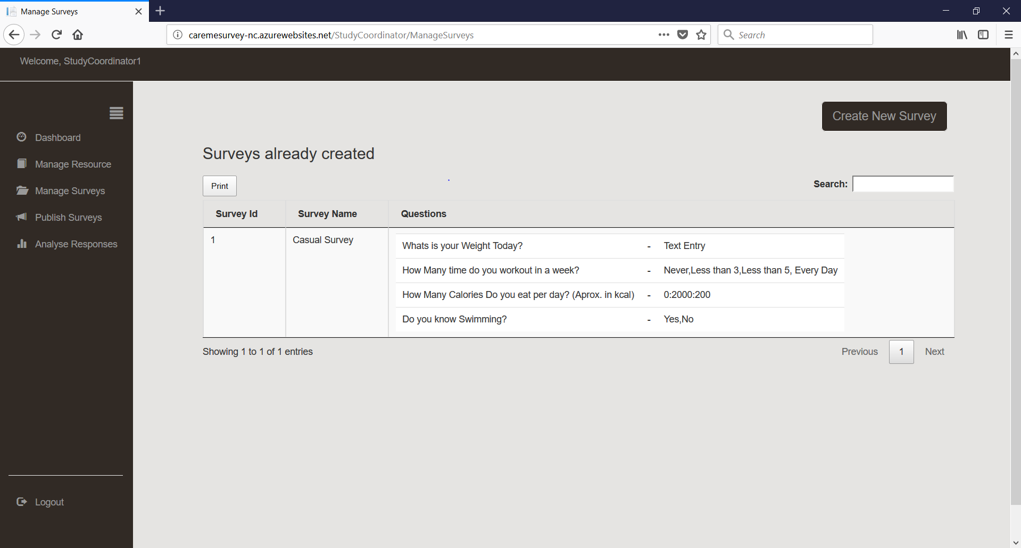
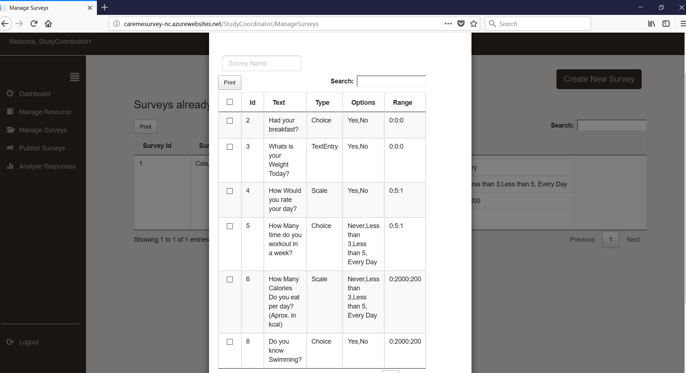
16
Coordinator for creating resources like Surveys
17
Preparing surveys

Slide 13
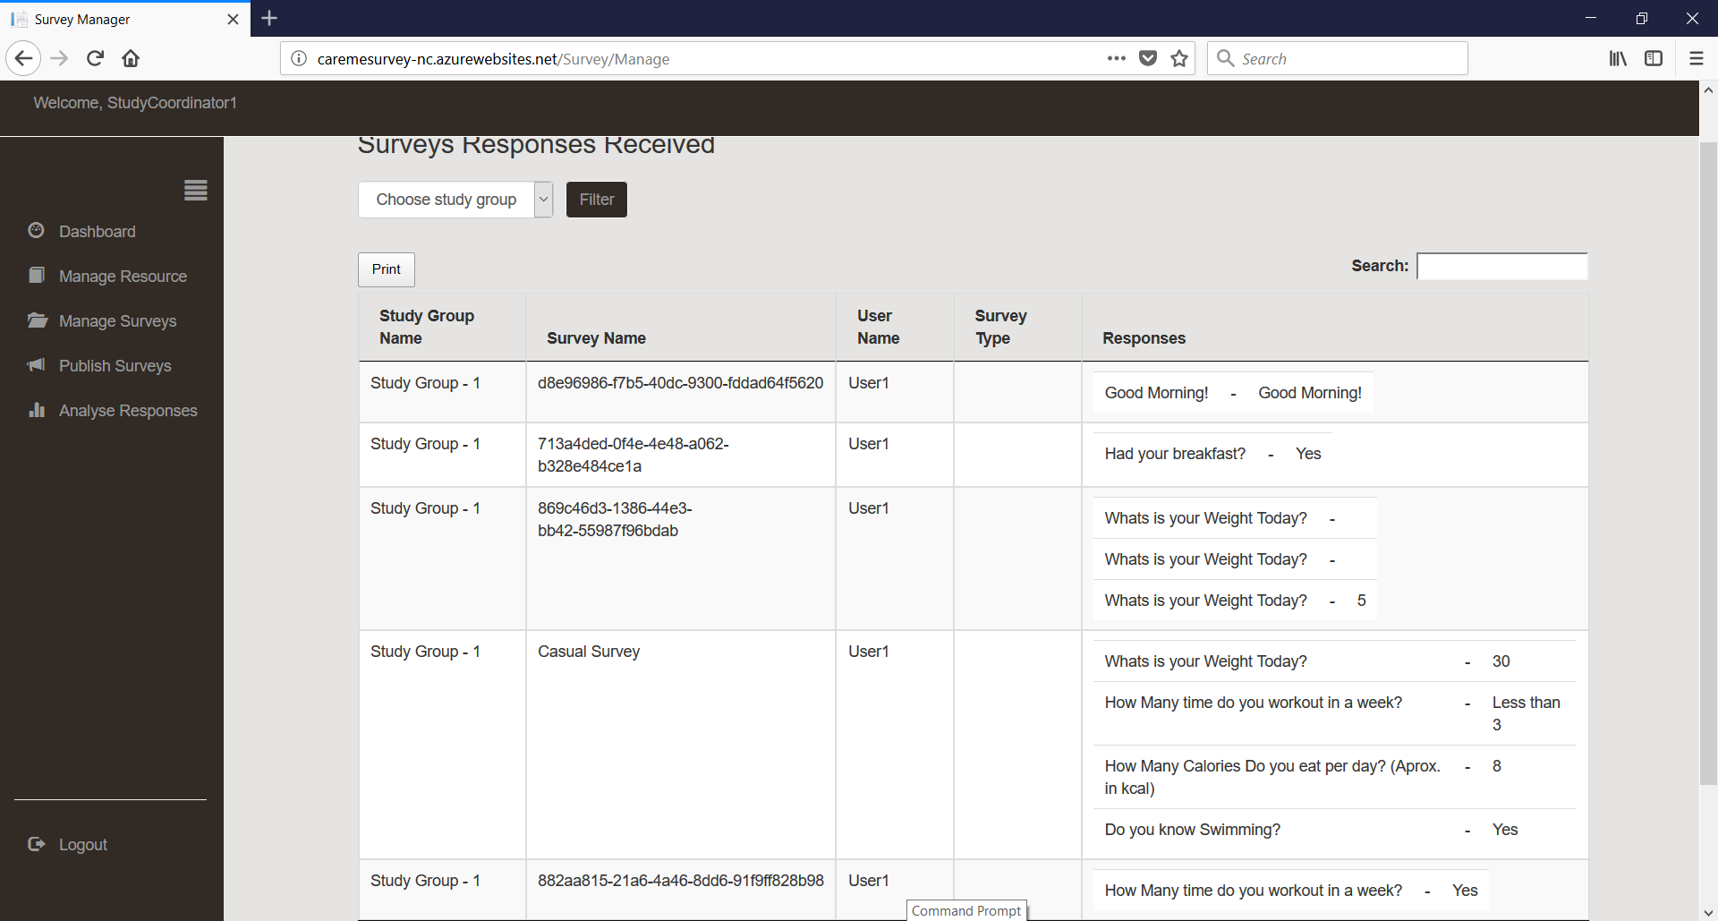
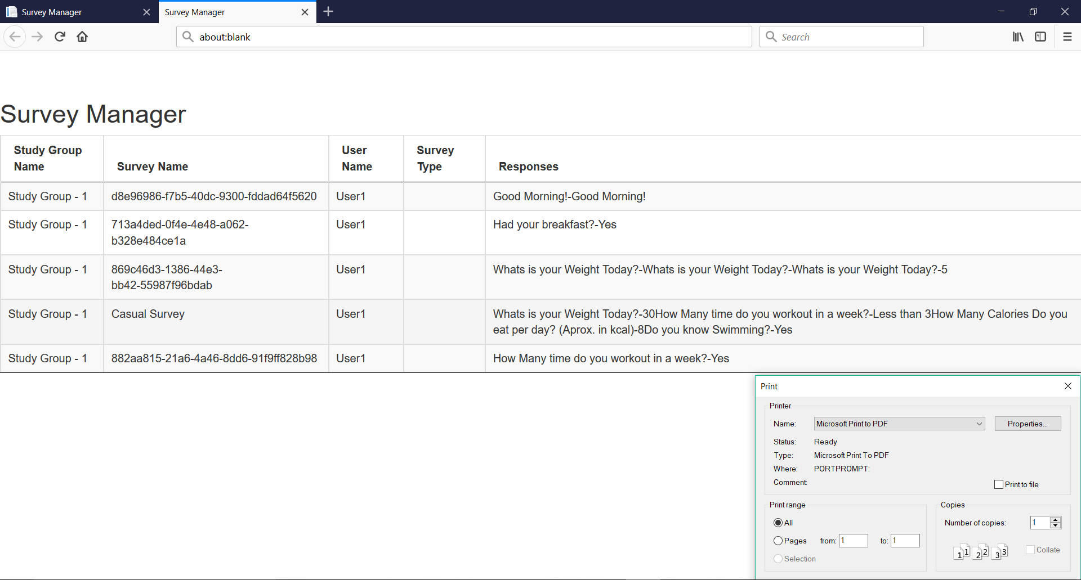

18
Coordinator for analyzing the responses received
19
Print option for any list that allows User or Coordinator to print

Slide 14
Technologies Used
Used ASP.NET Web API to design Application Programming Interface
Used Identity framework for roles based authorization
Used Entity framework as an ORM tool
Used ASP.NET MVC along with Knockout.js to develop web application
Used Bootstrap, Jquery,
Used DataTables to maintain all tables across web app
Used Researchstack on Android to develop mobile app
Used Google Cloud Messaging to implement push notifications

Slide 15
Responsibilities
Web app – Sunand, Usha
Mobile app – Nitin, Usha, Sunand
Web API – Ushaswini,Sunand

Slide 16
Tasks Not completed
More intense lists allowing user to navigate between them
Customize user interface of Mobile app

Slide 17
THANK YOU

